Slide 1
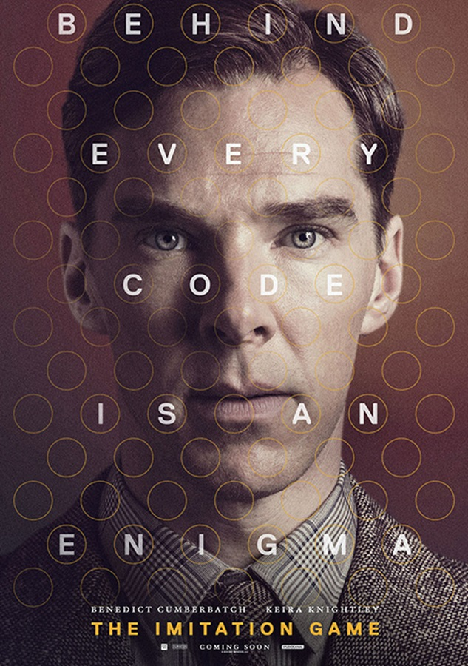
THE IMITAION GAME

Slide 2
INTRODUCTION

Slide 3
Introduction
Type – Historical, Drama, Thriller.
Directed by – Morten Tyldum.
Produced by – Nora Grossam. - Ido Ostrowsky. - Teddy Schwarzman.
Written by – Graham Moore.
Music By - Alexandre Desplat .
Editing by - William Goldenberg.
Production – Black Bear Porduction.
Country – United States.
Language – English.

Slide 4
Why we choosed this movie?
Alan Turing, an unsung hero.
Historical Drama.
Diverse.
Social issues.
Great Insights.

Slide 5
STORY LINE

Slide 6
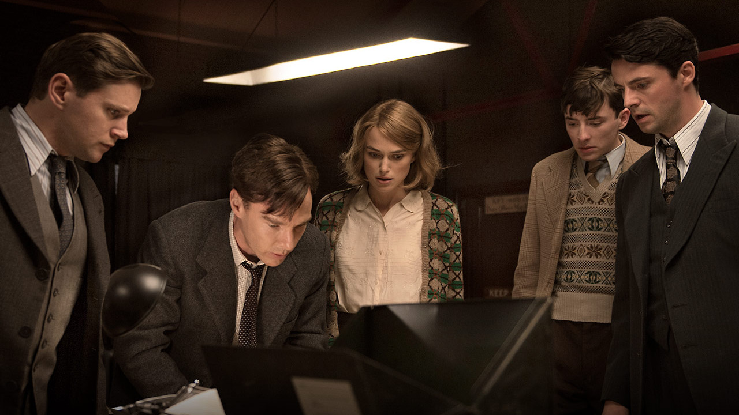
The beginning of the team Enigma
World war II and the Enigma
Meeting with Commander Denniston
Forming the Team Enigma

Slide 7
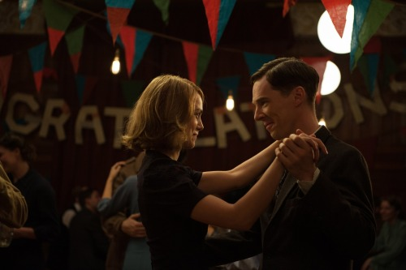
Alan meets Joan
Puzzle competition
Meeting Joan
Convincing Joan to join team Enigma
Reformation of team enigma
Engagement of Joan and Alan

Slide 8
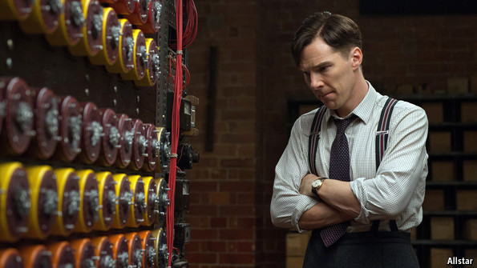
Breaking the enigma
Meeting with Helen
Eureka!
“Heil Hitler!”

Slide 9
Ending
Unsung heroes of war
Spy in the team Enigma
Christopher
Final days of Alan

Slide 10
CHARACTER ANALYSIS

Slide 11
Main Characters
Alan Turing
Joan Clark
Hugh Alexander
Detective Robert Nock
Commander Dennison

Slide 12
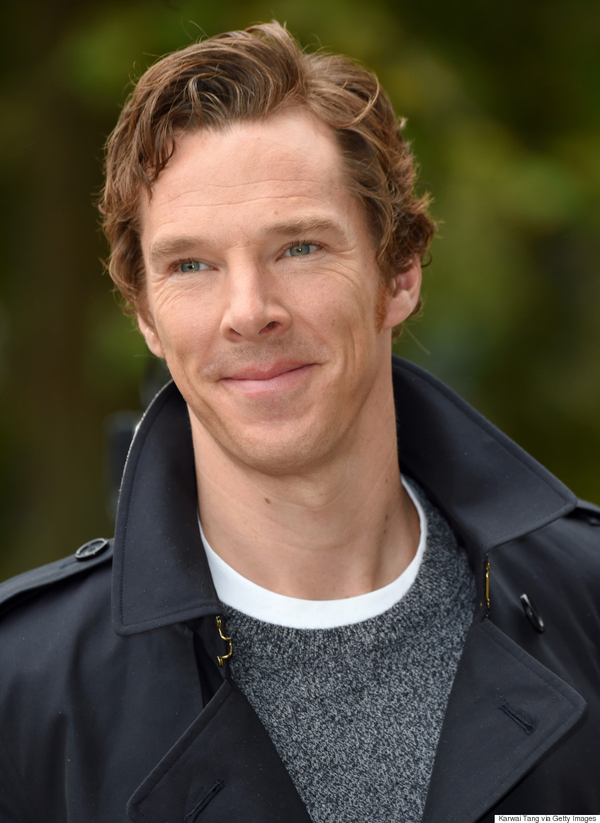
Alan Turing
Role played by Benedict Cumberbatch
Known for Sherlock TV show

Slide 13
Alan Turing
A genius Mathematician
Decrypted messages from “Enigma”
Has a great power of thinking

Slide 14
Alan Turing
Unsocial Being
Didn’t often make eye contact
Behavior wasn’t normal but he was open about them
Physically fit
Used to run a lot

Slide 15
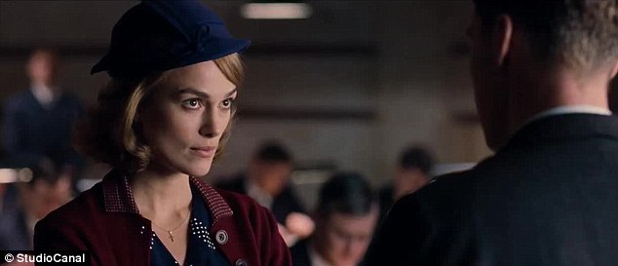
Joan Clarke
Role played by Keira Knightley
Was an English cryptanalyst
Was hard working
Was on Alan’s team
Both were good friends
Was a caring friend

Slide 16
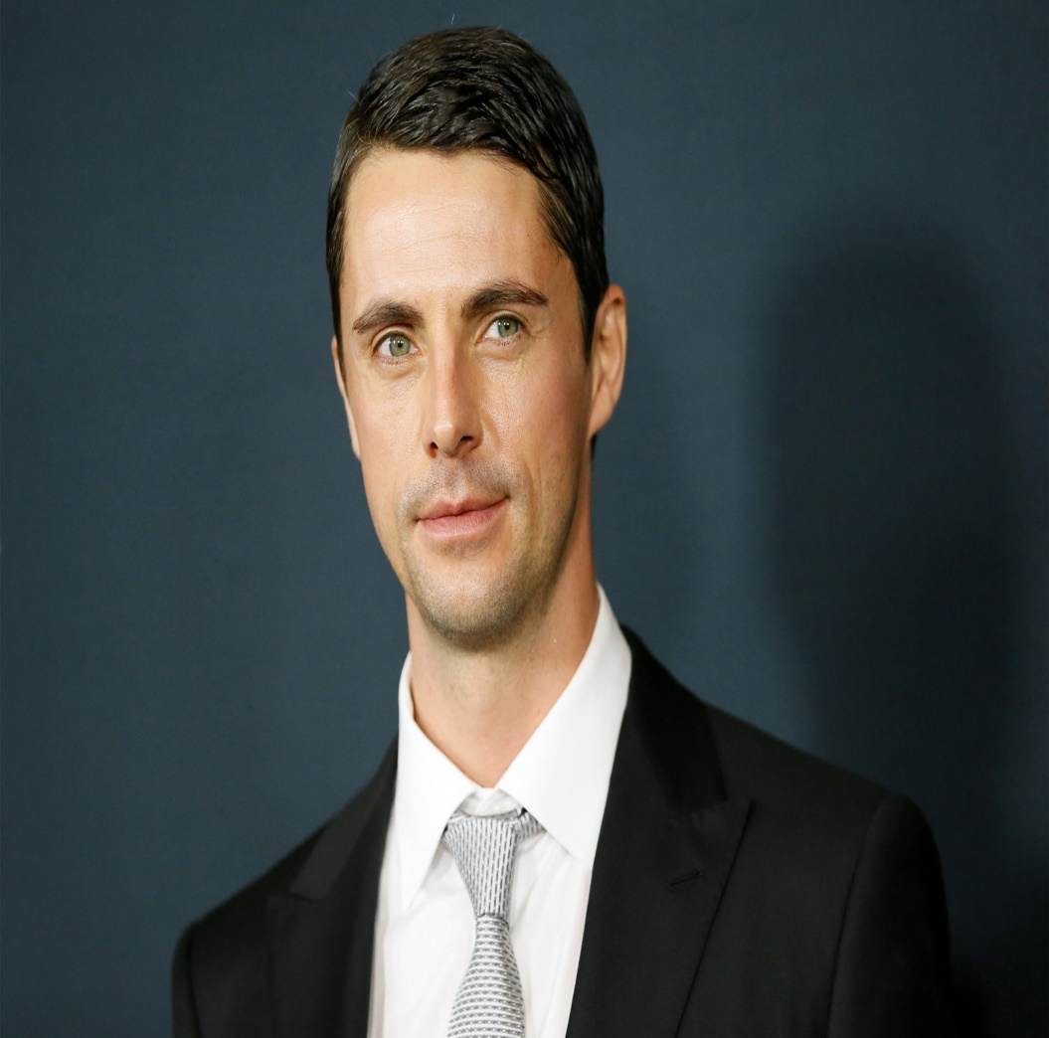
Hugh Alexander
Very intelligent man
Confident alpha male, who is very happy to lead the team
Likes to work as a team
Was very confident with his work
Nice and friendly person
Hardly trusts others
Bold personality

Slide 17
Strengths and Weaknesses

Slide 18
Strengths
Based on a true story
Historical movie
Intelligence of Alan Turing
Cumberbatch’s role

Slide 19
Weaknesses
Somethings changed
Unorganized finishing
Didn’t include the death of Alan Turing

Slide 20
Conclusion

Slide 21
What we can learn from The Imitation game?
1. “ Do Good Work to Get Good Work”
2. “ Sometimes It Takes A Bit Of Bravery ”
3. “ Think Big, Even When It Hurts ”
4. “ Unity is Strength ”
5. “ Turn Personal Loss into Professional Gain ”

Slide 22
Why you should watch The Imitation Game?
1. It brings Turing's story to the big screen.
2. It celebrates human ingenuity.
3. It will give you a perspective on Women’s and LGBT’s condition on that time.
4. It may inspire you to find out more.
5. All those things you can learn from previous slide.

Slide 23
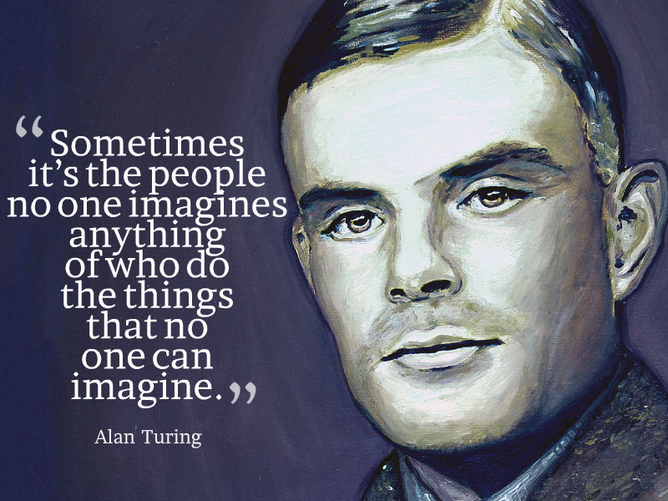

Slide 24
Go and Watch it! Thank You!

